Slide 1
Dealing with many to many relations
Dealing with many to many relations

Slide 2
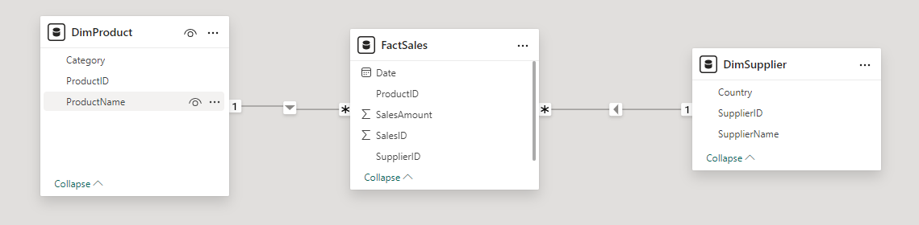
Dealing with many to many relations
Note: This Lab uses lab4.xlsx in Sales Model
Start by creating relationships between those tables this way:
FactSales → DimProduct (via ProductID).
FactSales → DimSupplier (via SupplierID).

Slide 3
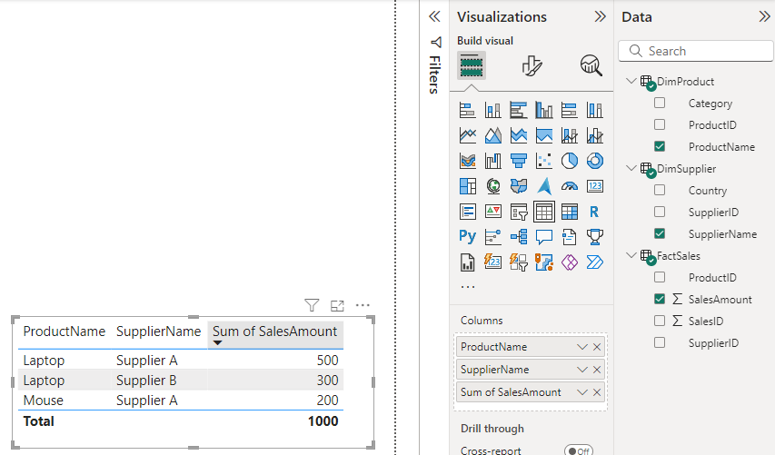
Dealing with many to many relations
The Problem now is that Products with no sales (e.g., new products), also suppliers supplying products not yet sold are also not represented.
Let ’s represent the data with a Table visual
Note missing Information:
no data for Monitor (Product 103) or Keyboard (Product 104)
Supplier C is not shown because it has no sales.

Slide 4
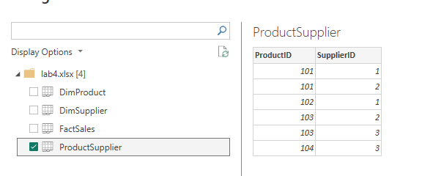
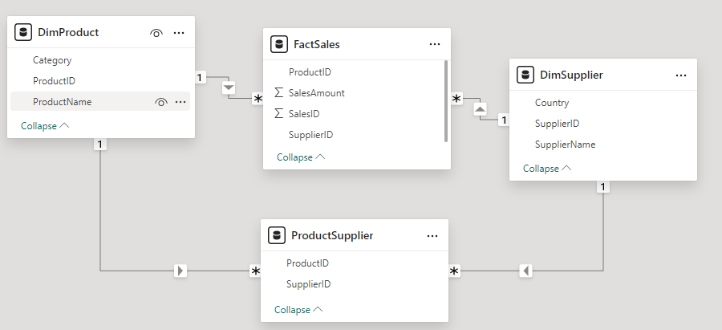
Dealing with many to many relations
Add now the ProductSupplier table

Slide 5
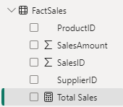
Dealing with many to many relations
Add a new measure to the FactSales table
Total Sales =
SUMX(
ProductSupplier,
COALESCE(
CALCULATE(SUM(FactSales[SalesAmount])),
0
)
)

Slide 6
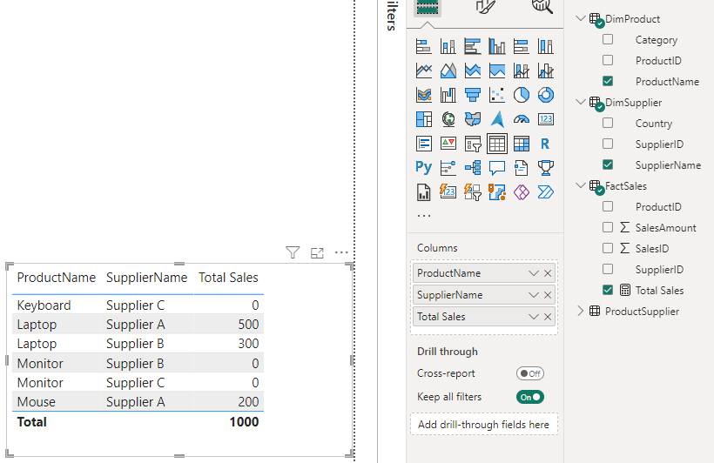
Dealing with many to many relations
Add a new Table visual ProductName, SupplierName and Total Sales as columns

Slide 7
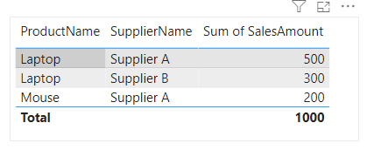
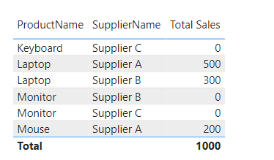
Dealing with many to many relations
Note the difference now
Without Many to many
With Many to many

Slide 8
Thank you
Thank you

